Slide 1

College of Health Sciences
FY 2024 Planning and Budget Meeting

Slide 2
College of Health Sciences
Department of Human Sciences
Department of Kinesiology
Department of Public Health
School of Nursing
SHSU Food Pantry
Tripod’s Thrift

Slide 3
FY 2023 Accomplishments
Priority 1: Prioritize Student Success and Student Access
  In Spring 2022 and Fall 2022, all Nursing majors had employment offers before graduation
  The Food Pantry had 3,148 visits and distributed 54,409 lbs. of food (April 2022 – February 2023) and Tripod’s had 1,075 visits (August 2023)
  Launched the first cohort of the COHS Bridge Scholarship Program
  In partnership with Haworth/FMG Houston, completed renovation of the new Senior Design Studio in Interior Design

Slide 4
FY 2023 Accomplishments
Priority 2: Embody a Culture of Excellence
  Increased (a) number of PIs submitting grants, (b) external grant submissions, (c) external grants awarded, and (d) funding amount in COHS
  98.5% NCLEX pass rate for SON
  94.7% pass rate on TExES Physical Education EC-12 exam
  Successful ACEND reaccreditation and CAATE accreditation site visits for the MS-Dietetics and MS in Athletic Training programs, respectively
  THECB grant – Graduate certificate in Public Health Data Analytics

Slide 5
FY 2023 Accomplishments
Priority 3: Elevate the Reputation and Visibility of SHSU
  Disseminated the inaugural COHS annual publication to COHS alumni and donors
  As part of Dr. Khalid Khan’s NIH grant, three students traveled to Bangladesh to collect data
  In September 2022, we held the 10-Year Celebration of the School of Nursing
  SHSU’s Exercise is Medicine workgroup tied for second place in the American College of Sports Medicine’s “mascot challenge.”
  Madelyn Cobb represented Fashion Merchandising at the UofNYFW, which was sponsored by CLC and SHSU Athletics
  Graduated our largest cohort and 1,000th nurse in the School of Nursing in Fall 2022
  Student and faculty participation in AIA Houston’s Health Symposium Exhibition and Social

Slide 6
FY 2023 Accomplishments
Priority 4: Expand and Elevate our Service to the State and Beyond
  Completed initial programming for the Health Professions Building
  Completed feasibility study for expansion of Nursing at The Woodlands Center
  Engaged in recruiting efforts with East Texas school districts to drive enrollment in COHS programs and encourage participation in forthcoming COHS Summer Camp (July 2023)
  Completed COHS pathways with Angelina College to promote ease of transition into COHS academic programs
  GEER II-Nursing Innovation Grant Program funded by THECB for $240K - focused on building the number and quality of preceptor and simulation educators in the community

Slide 7
Budget Request
#1 Budget Priority | Four Clinical Faculty Lines (1 Assistant Director for Clinical Learning, 3 Clinical Assistant Professors), School of Nursing
Aligned with Strategic Priority Goal | Strategic Priority 1, Goal 1: Recruit, retain, graduate, and empower students to drive sustainable growth
Amount Requested | Total: $372,672 (Assistant Director: $110,772, Clinical Assistant Professor: $87,300)
Frequency of Need | Recurring
Opportunity Statement | Assistant Director of Clinical Learning: For the past two years, this line has been funded by COVID and HEERF. This position oversees the recruitment, orientation, and management of adjunct clinical faculty, and identifies, affiliates, and maintains relationships with over 75 SON clinical partners who make almost 1,000 discrete placements every semester. Clinical Assistant Professor (3): These positions will help reduce reliance on adjunct faculty to support academic activities. The Texas Board of Nursing (TBON) identifies <35% full-time faculty as a risk for program failure. The SON is currently at 42% full-time faculty.
Risk Statement | Failure of clinical placement operations and potential imbalance of FT to PT faculty to the threshold of risk stipulated by TBON.

Slide 8
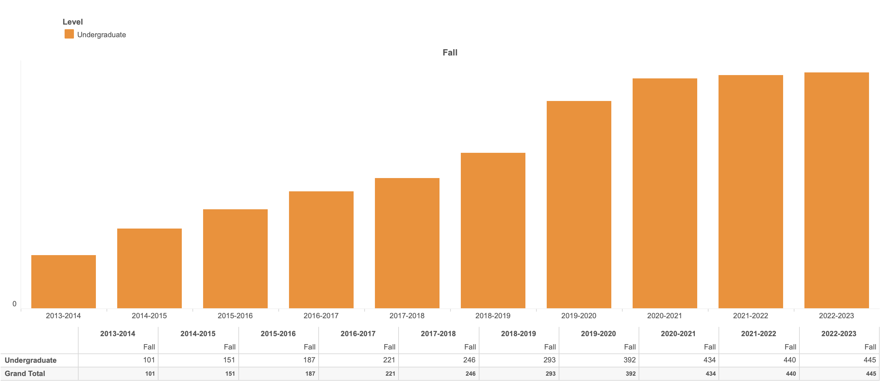
School of Nursing Enrollment

Slide 9
Budget Request
#3 Budget Priority
What is the request?
#2 Budget Priority | Program Directors for Proposed Doctor of Physical Therapy and Master of Science in Physician Assistant Programs
Aligned with Strategic Priority Goal | Strategic Priority 1, Goal 1: Recruit, retain, graduate, and empower students to drive sustainable growth
Amount Requested | Total: $406,000 ($203,000 each)
Frequency of Need | Recurring
Opportunity Statement | The Program Directors for the proposed DPT and PA programs are needed to develop the curriculum and accreditation (CAPTE and ARC-PA) required for program launches in the new Health Professions Building.
Risk Statement | Both the DPT and PA program directors are required per CAPTE and ARC-PA, respectively.

Slide 10
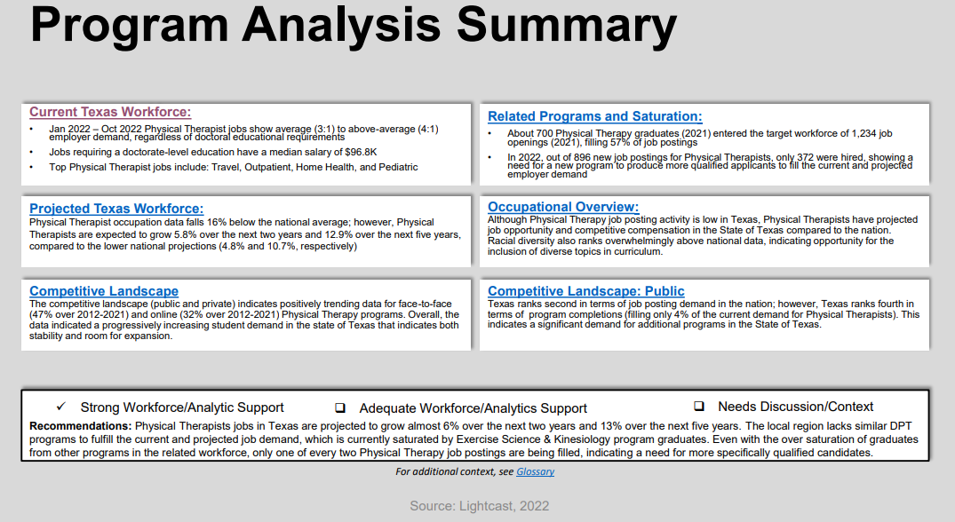
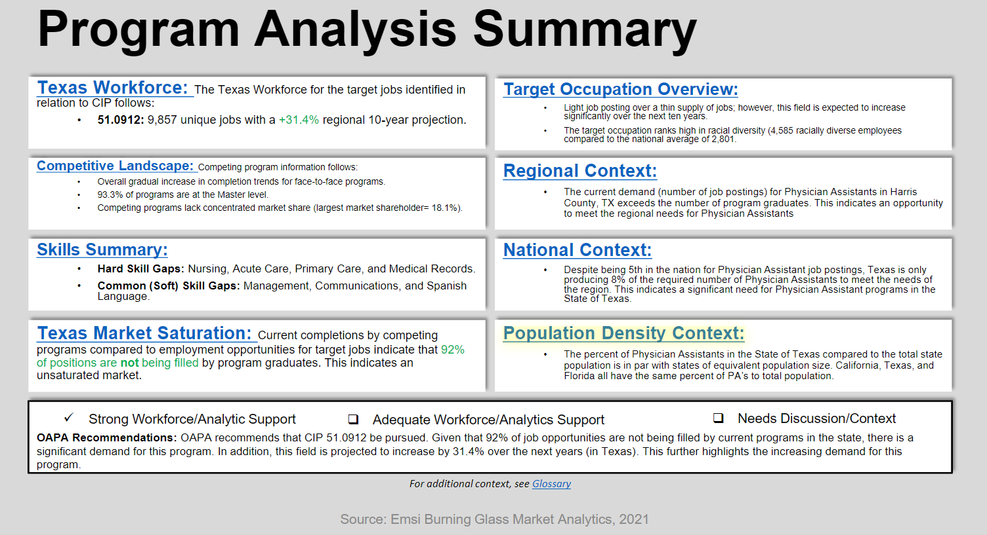
Program Analysis Data
Doctor of Physical Therapy Program
Strong workforce/analytic support
MS in Physician Assistant Program
Strong workforce/analytic support
Lightcast - 2022

Slide 11
Budget Request
#4 Budget Priority
What is the request?
#3 Budget Priority | Tenure-track line in Public Health
Aligned with Strategic Priority Goal | Strategic Priority 1, Goal 1: Recruit, retain, graduate, and empower students to drive sustainable growth
Amount Requested | $107,400
Frequency of Need | Recurring
Opportunity Statement | This line is needed to address growth in student enrollment since 2014. In addition, HLTH is developing a Master of Health Administration (MHA) program in partnership with COBA. Student-to-faculty ratios are the highest at the university for the Department of Public Health (73:1, March 3, 2023, Institutional Research).
Risk Statement | If unfunded, a reliance on adjunct faculty would continue as well as high student-to-faculty ratios. If unfunded, it also jeopardizes long-term stability and expansion of our existing undergraduate and graduate programs, while also delaying the development of an MHA program.

Slide 12
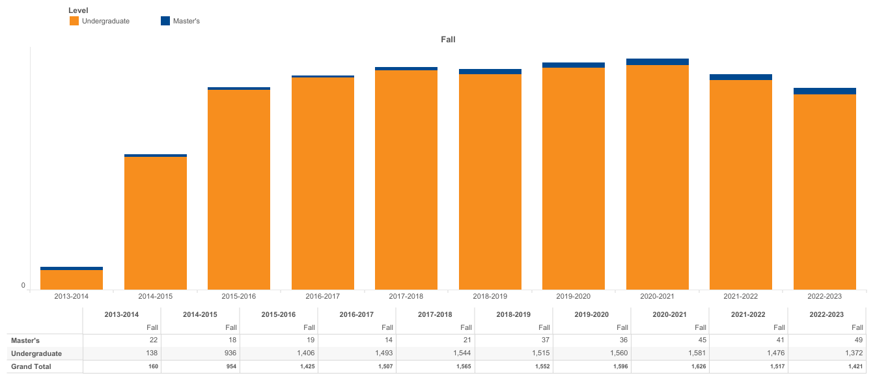
Public Health Enrollment

Slide 13
Budget Request
#5 Budget Priority
What is the request?
#4 Budget Priority | Tenure-track or Assistant/Associate Professor of Practice line in Sport Management (Kinesiology)
Aligned with Strategic Priority Goal | Strategic Priority 1, Goal 1: Recruit, retain, graduate, and empower students to drive sustainable growth
Amount Requested | $101,400
Frequency of Need | Recurring
Opportunity Statement | This new line is requested to maintain and expand graduate enrollment in the current MS in Sport Management program and pursue an undergraduate program in Sport Management. There is currently only one full-time faculty member dedicated to sport management as the program lost a tenured faculty member to 1.0 FTE administrative duties and another FT faculty member departed in June 2022.
Risk Statement | High level of dependence on adjunct faculty and inability to pursue the BS in Sport Management, which has been identified as a program option for significant growth potential in the Department of Kinesiology.

Slide 14
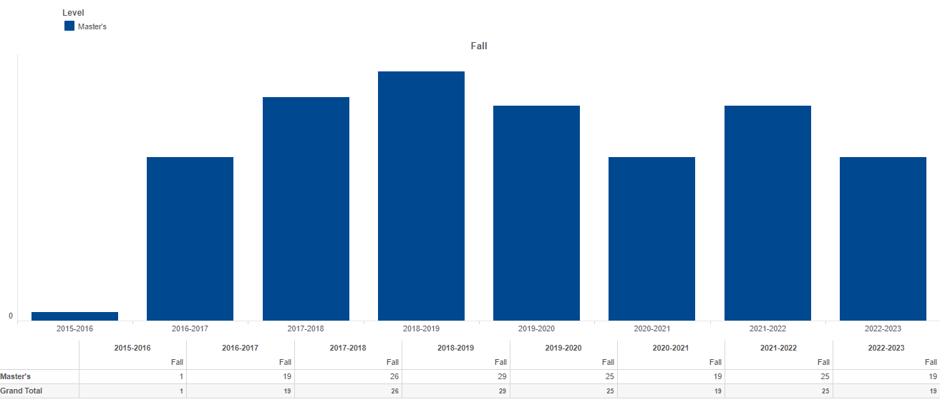
Sport Management Enrollment

Slide 15
Budget Request
#5 Budget Priority
What is the request?
#5 Budget Priority | Simulation Lab Equipment, School of Nursing
Aligned with Strategic Priority Goal | Strategic Priority 1, Goal 1: Recruit, retain, graduate, and empower students to drive sustainable growth
Amount Requested | $130,000
Frequency of Need | One-time – HEF eligible
Opportunity Statement | Simulation lab equipment and environmental enhancements needed to improve SON student learning and mitigate reliance on clinical partners.
Risk Statement | Inability to meet clinical hour requirements, particularly if additional public health emergencies or challenges with health care facility access arise.

Slide 16
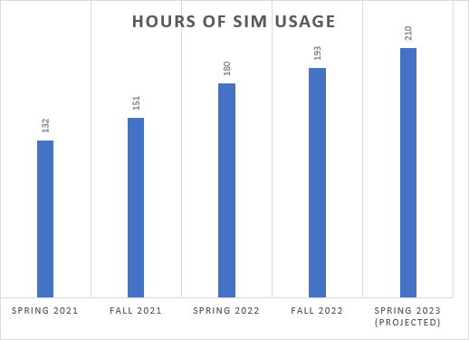
Simulation Usage

Slide 17
Summary of Budget Requests
Clinical faculty lines (4), Nursing – $372,672
Program directors (2), Physical Therapy and Physician Assistant – $406,000
Tenure-track line in Public Health – $107,400
Tenure-track or Assist/Assoc. Professor of Practice in Sport Management – $101,400
Simulation Lab Equipment, Nursing – $130,000
*Total Amount Requested – $1,117,472

Slide 18
Prospective “Big Ideas”
Address Texas nursing shortage – expansion of nursing
Development of a Simulation Hospital
Market-driven program development
  Master of Healthcare Administration
  Accelerated Bachelor of Science in Nursing
  Bachelor of Science and Master of Science in Social Work
  Bachelor of Science in Sport Management
Development of a Rural Health Center
Development of a Center for Youth Sport and Wellness

Slide 19
Questions?

